Slide 1
Ethical Theories (1)
Utilitarianism & Deontology

Slide 2


Slide 3
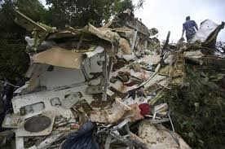

Slide 4
A dying millionaire’s wish
Suppose you’re on a remote mountain with a dying millionaire. He asks you for one final favour:
‘Throughout my life, rugby games have been giving me lots of pleasure. Could you help me give all my assets, F$4 million, to the Fiji Rugby Union so that this sport can be further developed in our country?’
You promise him to do so, but when you get back to Fiji, you notice a newspaper advertisement placed by your favourite charity organization World Hunger Relief pleading for F$4 million to save 100,000 people in Africa.
What should you do with the money?

Slide 5
Which principle can help?
‘You should always keep your promise.’
‘Let your conscience be your guide.’
‘Do whatever is most loving.’
‘Do unto others as you would have them do unto you (if you were in their shoes).’
Golden rule
‘Always maximize happiness and minimize pain (and suffering) for the greatest number of people, i.e., for the whole society (the whole world).’ -- utilitarianism

Slide 6
Which option maximises happiness and minimises pain and suffering?
Option 1
Donating F$4 million to Fiji Rugby Union
Consequences
Developing Rugby in Fiji further +100
Unable to benefit the African people - 300
…
Option 2
Donating F$4 million to World Hunger Relief
Consequences
100,000 people in Africa will be saved +500
Unable to keep a promise and benefit the Rugby lovers in Fiji -300
…

Slide 7
Main idea of utilitarianism
If an action is correct (e.g. just, fair, and caring), it must bring about the greatest happiness and the least pain (and suffering) for the greatest number of people.
Best option in terms of consequences
Comparison among different options

Slide 8
Utilitarian principle
Do whatever will promote the greatest happiness, welfare or utility value and minimize the pain and suffering as far as possible to the greatest number of people.
In short, maximize the net utility value (summing up the positive and negative values of pros and cons).
E.g. you have 3 options:
Option 1 (Pros: +300 hedons, cons: -200 hedons
net UV 100 hedons)
Option 2 (Pros: +100 hedons, cons: -200 hedons
net UV -100 hedons),
Option 3 (Pros: +400 hedons, cons: -100 hedons
net UV 300 hedons).
According to this principle, you should take Option 3.

Slide 9
Three features of utilitarianism
Consequentialist
The rightness or wrongness of an act is determined by the goodness and/or badness of the results that flow from it.
Note: not determined by the action itself.
Utility value
The only thing that is good in itself: pleasure, happiness and welfare
(What is bad is displeasure, pain, suffering, etc.)
Note: the concerns are not merely individuals’ but the society’s benefits.
Egalitarian
Everyone’s happiness is to be weighed equally.
Not giving self-interests a higher rank

Slide 10
The human goods
According to utilitarianism, different values can be weighed by translating them into a universal, quantitative, one: utility value (or in other terms, happiness, welfare, etc.).
Different values can be compared.
E.g. Repairing a washing machine ---- 40 hedons
Friendship ------------------------ 200 hedons
Good health ---------------------- 200 hedons
Scientific discovery --------------- 100 hedons
Art work ---------------------------- 100 hedons
Family love ------------------------- 300 hedons
The weighting varies case by case.

Slide 11
E.g. (A) Working 8 hours per day
→good health (+100 hedons)
→unable to support children’s education
(-200 hedons)
NET: -100 hedons
(B) Working 15 hours per day
→ bad health (-100 hedons)--cost
→ able to support children’s education
(+200 hedons)--benefit
NET: +100 hedons
→Moral judgments can be made by calculation and cost-benefit analysis. In the above case, (B) is the correct choice.

Slide 12
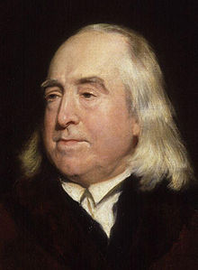
Jeremy Bentham (1748-1832)’s hedonic calculus
The quantitative score of any pleasure or pain experience is obtained by summing the seven aspects of a pleasurable or painful experience:
Intensity
Compare: Watching a movie, having a grade A, becoming a Nobel laureate
Compare: having a cancer, having a cold, unemployment
Duration
Certainty
What is the probability that the pleasure or pain will occur?
Compare: Having a Pass in this Unit, Having fun in the coming Picnic, Enjoy your life when you work in NZ
Nearness
How far off in the future is the pleasure or pain?

Slide 13
Fruitfulness (or fecundity)
What is the probability that the pleasure (sensation) will lead to further pleasure (sensation of the same kind)?
Compare: Learning ethics, Eating ice-cream, Friendship
Purity
What is the probability that the pleasure (sensation) will not be followed by pain (sensation of the opposite kind)?
Compare: Smoking, Reading a good book, Plagiarism
Extent
How many persons are affected by the pleasure?
Compare: Being a volunteer at an elderly home, Meditation, Playing Bridge
Any problem?

Slide 14
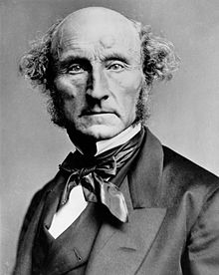
John Stuart Mill (1806-1873)
Distinguishes happiness from mere sensual pleasure
Higher-order pleasures or satisfactions
Intellectual, aesthetic and social enjoyments
High culture, friendship, scientific knowledge, creativity and spirituality
More protracted, continuous and gradual
Lower
Eating, drinking, sexuality, resting, and sensuous excitement

Slide 15
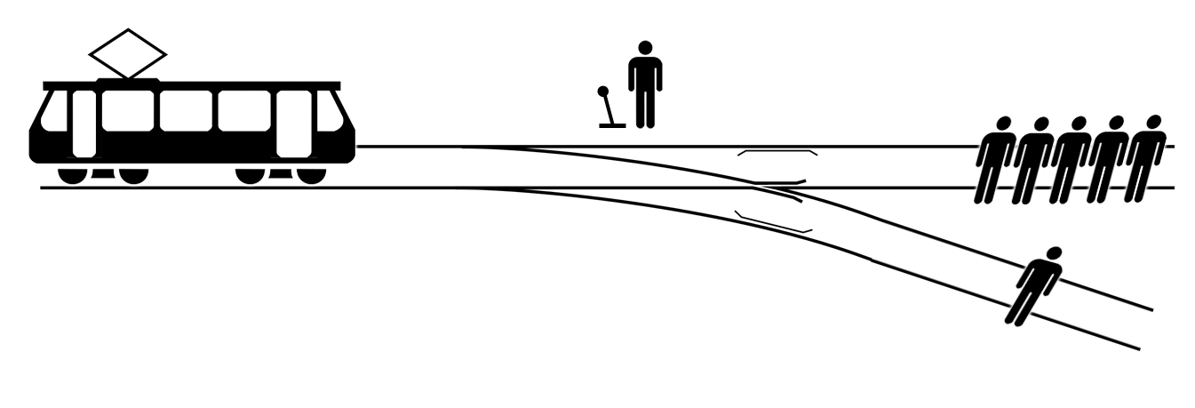
Trolley problem (1)
Would you do nothing or pull the lever?
How would a utilitarian do in this situation?

Slide 16
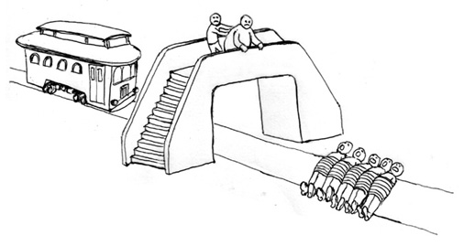
Trolley problem (2)
Would you push the fat man off the bridge to prevent the greater tragedy?
Would a utilitarian do so?

Slide 17
Two types of utilitarianism
Act-utilitarianism
Calculate the utility value (i.e. potential happiness and potential pain and suffering) for the greatest number of people that will be brought about by an Act.
Rule-utilitarianism
Calculate the utility value (i.e. potential happiness and potential pain and suffering) for the greatest number of people that will be brought about by practising a principle or rule.
E.g. Do not murder.

Slide 18
Rule-utilitarianism
Definition:
An act is right if and only if it is required by a rule that is itself a member of a set of rules whose acceptance would lead to greater utility for society than any available alternative.
‘Keep your promise’ – ‘Trust others’ – ‘Be truthful’ – ‘Respect others’ – ‘Cooperate with others’ …
Note: A legal system (human rights law included) has great utility value.

Slide 19
The justice objection
Suppose you are a utilitarian physician who has five patients under your care. One needs a heart transplant, one needs two lungs, one needs a liver, and the last two each need a kidney. Now into your office comes a healthy man needing an immunization. You judge that he would make a perfect sacrifice for your five patients.

Slide 20
A utilitarian would respond …
We value legal laws because they protect ourselves and others from arbitrary and biased acts (like the physician’s) that would in the long run bring about great pain and suffering.
The legal laws are just only if they maximise happiness and minimises pain and suffering for the greatest number of people.
But we do not worship legal rights or laws. If they do not benefit us, we shall abandon them.
Remember: Moral and legal rules are made for humans, not humans for moral and legal rules.

Slide 21
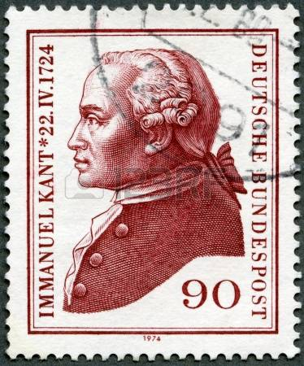

Slide 22
Deontology: genuine happiness requires respect to moral laws
Immanuel Kant (1724-1804) is the most important founder of deontological ethics. (It is also called Kantian ethics.)
‘deon’ = obligation, duty
That is why this ethical theory is often described as ‘obligation-based ethics’ or ‘duty-based ethics’ or ‘rule-based ethics’.
A morally right action should be made out of moral duty, rather than out of its desirable consequences.

Slide 23
A difference from utilitarianism
B kills one person → B can save 10 people.
B does not kill one person →10 people will die.
Which option would a utilitarian choose?
Deontological ethics will reject. Why?

Slide 24
Do not murder.
Rule-utilitarianism
We practise this principle because it brings about the greatest happiness for the greatest number of people.
Deontology
We practise this principle because it is a moral law.
We follow the moral law, not based on the utility value that is brought about by it.
We respect the moral law itself. As a rational being, we have an obligation or duty not to kill people.

Slide 25
Motivated by moral duty (i.e. by moral law)
A moral action is NOT motivated by self-interests, self-preservation, sympathy and happiness, which need not have moral worth.
BUT a moral action is motivated by moral duty as stipulated in the universal moral law.
E.g. Suppose I am a boss. I hired a person because he is my relative. What moral duty or moral law does this action violate?
E.g. Suppose I am a shopkeeper. I am very helpful to the customers because I would like my manager to praise me. What moral duty or moral law does this action violate?

Slide 26
Respect for moral law
= Respect for practical reason
We respect moral rules in so far as they do not violate values, laws or principles that we cherish.
E.g. I obey the regulations of FNU only if they do not violate the laws of Fiji; and I obey Fiji’s laws only if they do not violate the moral laws laid down by practical reason.
Note: Practical reason should have universal, not merely social, significance.

Slide 27
‘Moral duty’ does not rest on social convention.
‘Moral duty’ ≠ the duty prescribed by some code of conduct of a particular organization (for instance, a company)
‘Moral duty’ ≠ the duty prescribed by the moral system of a particular society
By ‘moral duty’, deontology refers to the obligation that is prescribed by the universal moral law (i.e. by practical reason).
E.g. a bus driver and a primary school student

Slide 28
Categorical imperative (CI)
The fundamental principles of our moral duties (of what we ought to do)
Imperative – because it commands us to do something and not to do something
Not indicative (i.e. not making a factual statement)
Categorical – because it applies to us unconditionally; not conditional on any goals or interests.
Not hypothetical
Examples: ‘Do no harm to others’ (not: ‘Do no harm to others if you love them’) ; ‘Don’t disregard the elderly people’ (not: ‘Don’t disregard them if you have time’); and so on.
CI has this form: ‘Do x’ or ‘Don’t x.’

Slide 29
A maxim
A personal rule.
E.g. ‘I am committed to help my friend whenever he is in a difficult situation in order that he can overcome it.
E.g. ‘I always try my best to earn as much money as I can in order to give more happiness to my family.’
E.g. ‘I shall always be honest in all circumstances in order to be trusted and have less stress.’
Moral law
An objective and Universal principle of volition
Note: not only concerning me
E.g.
‘Everyone should not cheat others.’
‘Work hard.’

Slide 30
The first formulation of CI: Universal law of nature
‘Act only in accordance with the maxim through which you can at the same time will that it become a universal law.’
Test these maxims:
Maxim¹ : I will make a promise that I have no intention to fulfill in order to obtain promotion in my job.
Maxim² : I will never tell others my real intention.
Maxim³ : I will help my friend when s/he is in danger.

Slide 31
The second formulation of CI: The Humanity Formula
‘Act in such a way that you treat humanity, whether in your own person or in the person of another, always at the same time as an end and never simply as a means.’
A simple version: Treat people as an end, not merely as a means.
The idea of respect for persons – not human beings in a biological sense but the ‘Humanity’ in human beings.
Humanity = the quality of being a person who has (at least potential) capacities to engage in self-directed rational behaviour; to adopt and pursue her own ends

Slide 32
The main points
We should not take other people as tools for our own purposes.
We should not use others as if they are an object.
We should not take ourselves as tools for happiness or less pain. (Accordingly, should suicide or euthanasia be allowed?)
We should respect others since they are persons.

Slide 33
Some objections
Deontology is too rigid: solely following moral principles and disregarding consequences.
Reply: A medical doctor has to consider the consequences of using certain kinds of therapy. But in making a moral judgment whether to do, say, plastic surgery, for a woman, s/he should treat the woman as an end, not merely as a means for earning money or other purposes. That means, the doctor should follow the categorical imperative.
Deontology has its emphasis on reason. Moral sentiment and feelings are not given enough attention.

Slide 34
Deontology or Utilitarianism?
‘Internet conducts like unauthorized computer entry, bullying, copying software, are wrong, and must be prevented, because these conducts will hinder the healthy development of the world wide web and bring about insecurity and other kinds of harms for web users.’

Slide 35
Deontology or Utilitarianism?
‘As the CEO of our corporation, I wouldn’t bribe the government officials in order to get any advantages for our projects, even though the success or failure of these projects would involve billions of dollars.
It is our moral obligation to compete in the market in a fair way.’

